Slide 1
Passvizor: Revolutionizing soccer analysis Teja Vineeth Reddy Yeramareddy
Luddy School of Informatics and Computing Technology
INDIANA UNIVERSITY INDIANAPOLIS

Slide 2
Introduction
SECTION 1

Slide 3
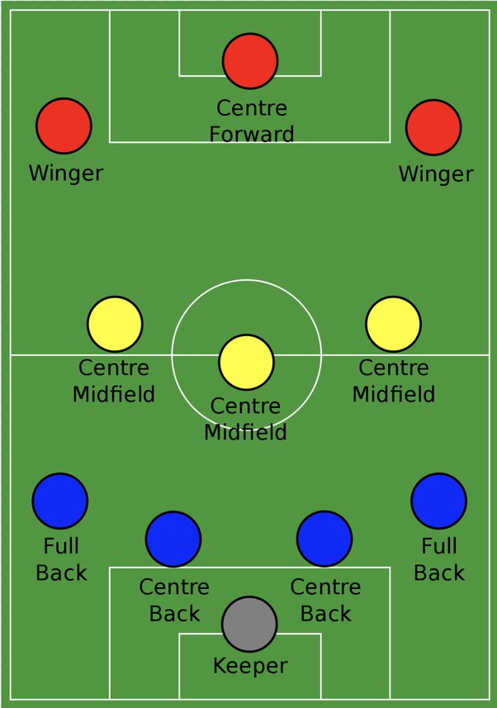
Soccer: It’s a global sport, has always been subject of scrutiny and analysis.
Department : Attack, Mid & Defence.
Formation: 4-3-3, 4-2-2-2 etc.
Passing Tactics: Tiki-Taka, Counter attack, Long ball etc.
Phases: Attack & Defence (and Holding sometimes.)
Passing Structure : Different phases requires different structure.
Fig-1: Soccer Basic Formation. Can Find it Here
Luddy School Of Informatics

Slide 4
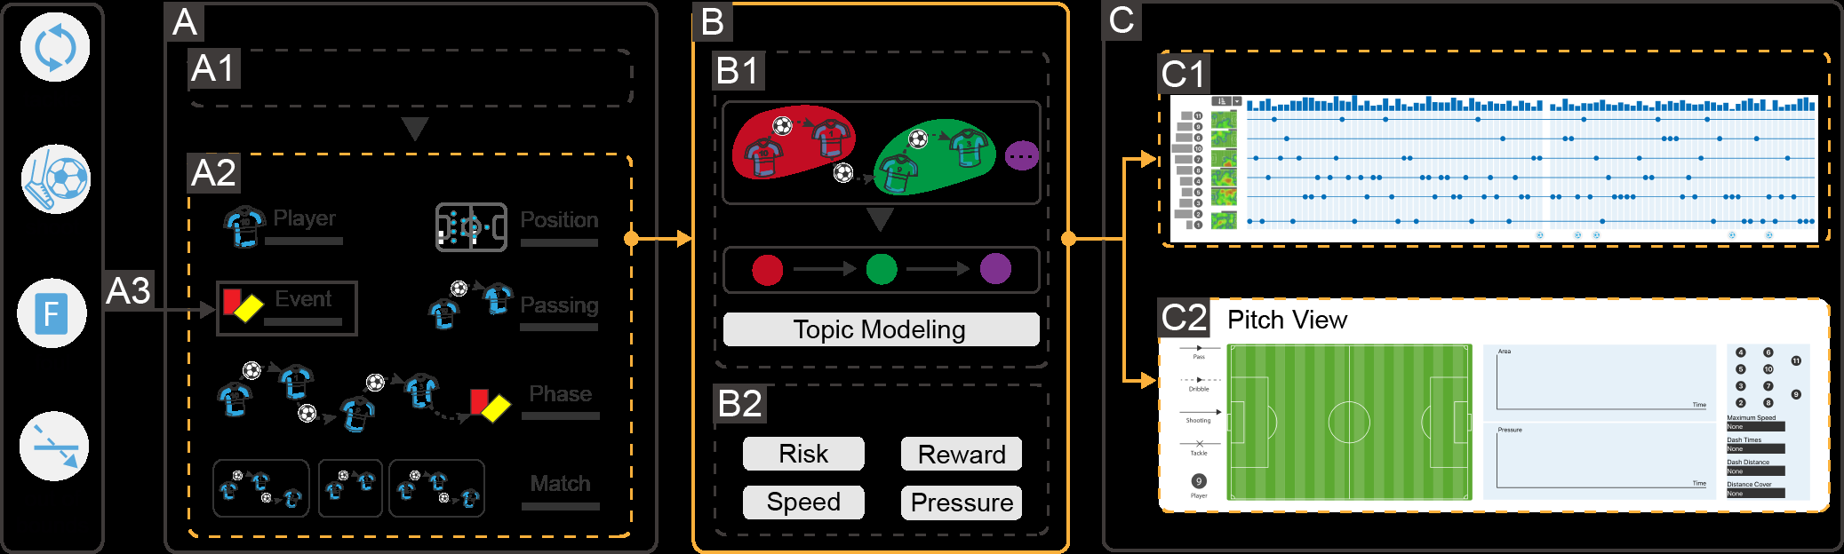
PassVizor : A Game-Changer in Soccer Passing Analysis
Improves the team performance using the passing data.
Soccer is dynamic and has different phases in a match.
PassVizor was meticulously crafted through collaboration with domain experts to represent a groundbreaking visual analytics system that provides a high-level abstraction of intricate passing behaviors, enabling a deeper understanding of the dynamic shifts in a team’s passing tactics.
Employs a topic-based methodology inspired by the structural similarities between passing sequences and sentences.
Luddy School Of Informatics

Slide 5
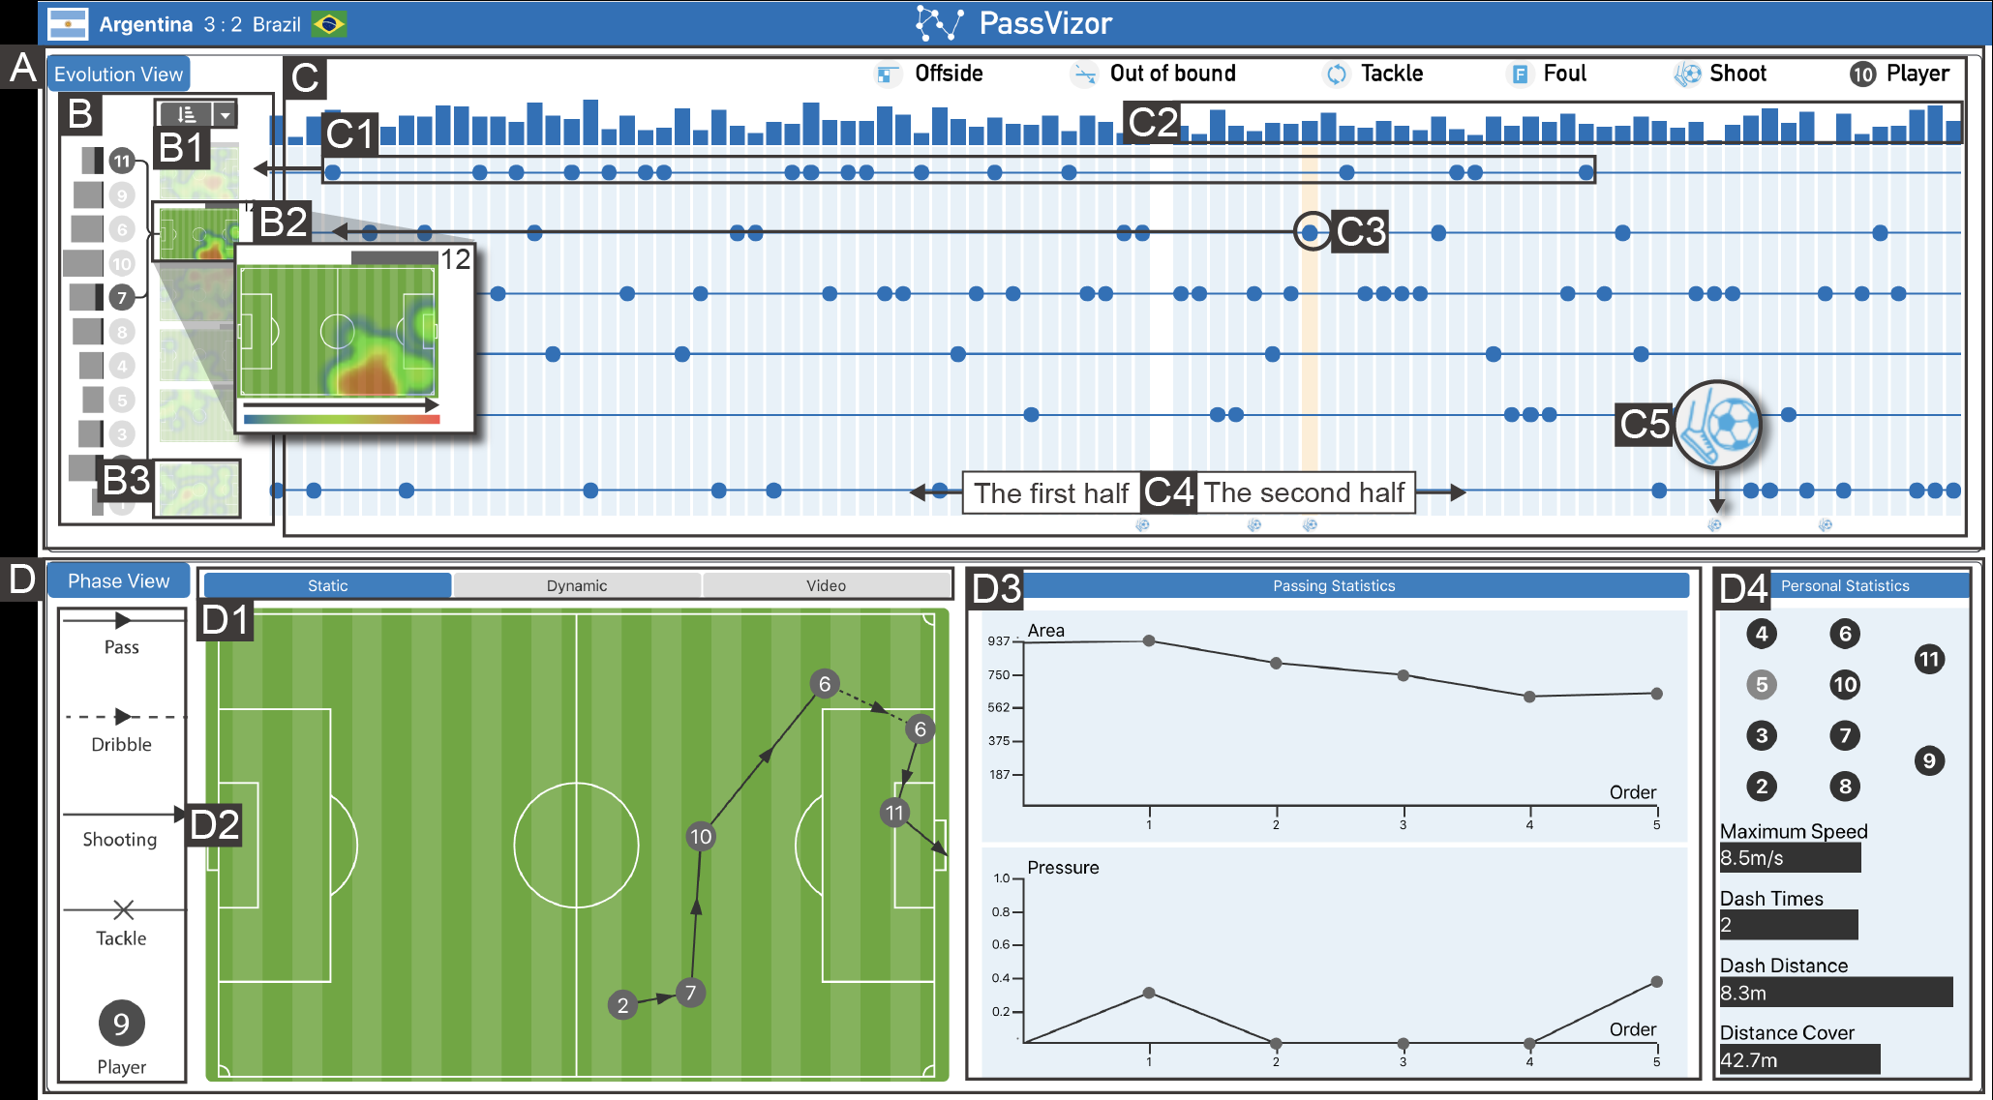
How PassVizor Works?
Employs glyphs, small visual icons, to encapsulate a plethora of information about each pass.
Employs covered regions of opponents to represent the defense’s effectiveness, with smaller covered regions signifying a well-structured defensive formation.
Three Key Views : Passing Pattern, Passing Network & Passing Detail View.
Luddy School Of Informatics

Slide 6
Applications of PassVizor
By analyzing the dynamic changes in a team’s passing tactics throughout a match, experts can extract valuable insights into team performance.
With its topic-based approach and innovative glyph-based visualization, PassVizor offers a comprehensive solution to the complex task of analyzing soccer passing.
This tool provides invaluable insights into team performance, enabling experts to make informed decisions that can shape the outcome of matches.
Experts can pinpoint players who are heavily involved in the passing game and those who may need to step up their contributions and helps them to make tactical adjustments during a match and develop tailored training programs for individual players.
PassVizor’s development represents a significant advancement in soccer analytics, paving the way for a deeper appreciation of the beautiful game.
Luddy School Of Informatics

Slide 7
Questions :
Considering the potential benefits of PassVizor in soccer analysis, what challenges or barriers might coaches face in adopting this tool into their coaching strategies and routines?
Is there a risk that placing too much emphasis on passing tactics, might overshadow other aspects of the game, such as individual player skills, teamwork, or defensive strategies? How should coaches strike a balance when using such analytical tools?
To what extent, does the role of luck or chance in the outcomes of passes and their impact on a team’s performance?
Ethical considerations in sports analytics have gained attention in recent years. How does these kinds of tools address or potentially raise ethical concerns, such as player privacy, data security, or the potential for over-reliance on analytics in decision-making?
Can PassVizor’s principles and techniques be adapted or extended for use in other team sports that involve passing, such as basketball, American football, or field hockey? What modifications or considerations would be necessary to make it applicable to different sports?
Luddy School Of Informatics

Slide 8
THANK YOU

